Slide 1
SoluM ESL Cloud System
Internal Only
ICT Precedent Development Group
2021.01.21

Slide 2

















SoluM ESL Cloud System
Azure Kubernetes Cluster
User Node Pools
EventHub
APIService-Imggenerator
Active Directory B2C
API Service
ImageGenerator
Ingress
Controller
EventHub
Imggenerator-Outbound
SSL Offload
HTTP
HTTPS
VNET
Peering
Customer
Application Gateway
WAFv2
HTTPS Certificate issued by Let’s Encrypt
Dashboard
Inbound
PostgreSQL
Ingress
Resource
Egress Packets from some microservices
Storage
for GW and Labels
MongoDB
Layout Designer
Outbound
Label
ESL Gateway
IoTHub
EventHub for Inbound
Storage
for management
PDA
DPS
Container Registry
DevOps
Global Time Server(NTP)

Slide 3

High Availability (HA) & Disaster Recovery (DR)
Possible but the cost will be more than double !!!
https://www.anujvarma.com/azure-high-availability-iaas-with-traffic-manager-architecture/
https://docs.microsoft.com/en-us/azure/aks/operator-best-practices-multi-region
By using an additional service “Traffic Manager”, we can do this as below but have to consider stability and costs.
Managed by SoluM
AKS
PostgreSQL
DPS
Ingress
Controller
EventHub
MongoDB
Application Gateway
WAFv2
IoTHub
ESL Gateway
Data
Backup
Customer
AKS
PostgreSQL
Traffic Manager
Label
Ingress
Controller
Storage
for GW and Labels
EventHub
MongoDB
Application Gateway
WAFv2
Managed by SoluM

Slide 4



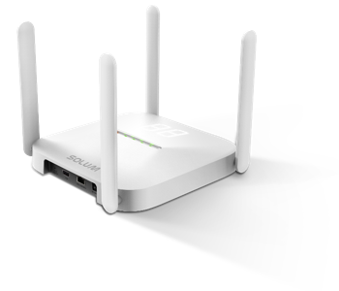




Network Ports used by ESL Gateway
DPS and IOT Hub (MQTT over Web Socket , 443 ports)
GWs communicate with Azure Device Provisioning Service first
After receiving IoTHub URL and deviceId successfully, GWs communicate with Azure IoT Hub
Storage (HTTPS, 443)
GWs download files (Images, NFC, schedule, OTA files and so on) from Azure Storage.
NTP (UDP, 123)
Local NTP server cannot be used for cloud system.
All ESL server micro-services and GWs need to use a common NTP server.
SoluM ESL SYSTEM based on Azure Cloud
Customer’s store
NTP (UDP, 123)
DPS (MQTT over WS, 443)
IotHub (MQTT over WS, 443)
Storage (HTTPS, 443)

Slide 5
Communication Matrix
The below table describes which services based on network are used in customers’ stores.
For your information,
Egress IP address and ingress IP address of services running on AKS are different.
Azure Services can be accessed by using their fixed domain names and their IP addresses can be changed due to High Availability.
Sometimes, ntp.ubuntu.com doesn’t work properly. So, we recommend to open the firewall for time.google.com on customers’ network.
Service | Source (Devices on store) | Destination | Protocol & Port | Comments
SoluM ESL Service | Customers’ Machines (PC / PDA / Client) | Dashboard / API Server / PDA running in AKS | HTTPS – 443 | The IP Addresses for Ingress and Egress are different.
Azure Device Provisioning Service (DPS) | Gateway | Azure DPS | MQTT over WS – 443 | global.azure-devices-provisioning.net
Azure IoTHub | Gateway | Azure IoT Hub | MQTT over WS – 443 | xxxxxx.azure-devices.net
Azure Storage | Gateway | Azure Storage | HTTPS – 443 | xxxxxx.blob.core.windows.net
Network Time Protocol (NTP) | Gateway | NTP Server (Using one of predefined servers) | UDP – 123 | time.google.com, (216.239.35.4,216.239.35.12, 216.239.35.0, 216.239.35.8) ntp.ubuntu.com, (91.189.89.199, 91.189.94.4, 91.189.89.198, 91.189.91.157)

Slide 6
Requirement for using ESL GW
DHCP Server
On Cloud Mode, we recommend to use DHCP mode.
Proper firewall outbound rules (According to circumstances, the protocols and the ports can be changed)
ESL Gateways communicate with SoluM Cloud system and other services
NTP Server - (UDP, 123)
To avoid some issues, ESL GW uses the below predefined public NTP servers.
(Public NTP servers) time.google.com, pool.ubuntu.com, pool.ntp.org
Local NTP servers are not used.
Device Provisioning Service (DPS) - (MQTT over WebSocket, 443)
ESL Gateways must be registered on SoluM DPS server before using them.
Azure Storage - (HTTPS with Shared Access Signature Key)
To download image files, OTA files and etc.
Azure IoTHub - (MQTT over WebSocket, 443 Port)
To send the status of GW and Labels to ESL Server
Dashboard , PDA, Android App for users
Ethernet Bandwidth
Min. 1Mbps and above (For better performance, we recommend to assign high Ethernet bandwidth to ESL GWs )
RF Channel Configuration for better performance between Label and GW
To avoid RF conflict among WIFI, BLE and other devices, RF Channels (Data Ch., Alive Ch. and Scan Ch.) of ESL GW should be properly assigned after checking RF Environment by using “Channel Analyzer” such as wi-spy.

Slide 7
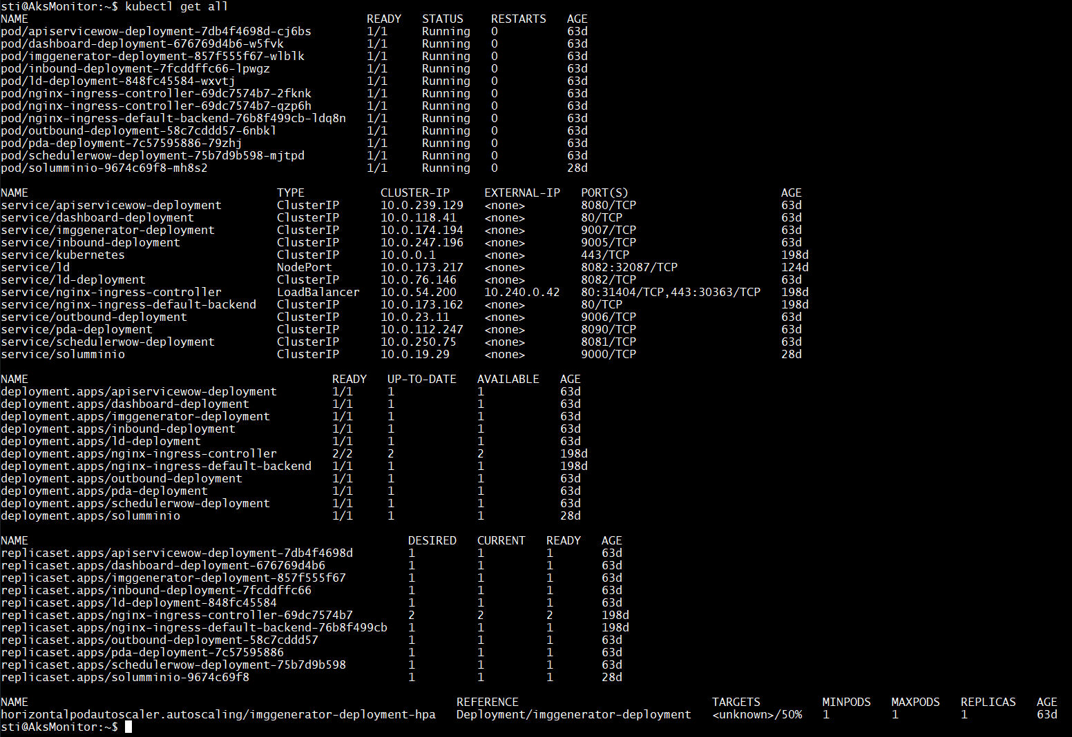
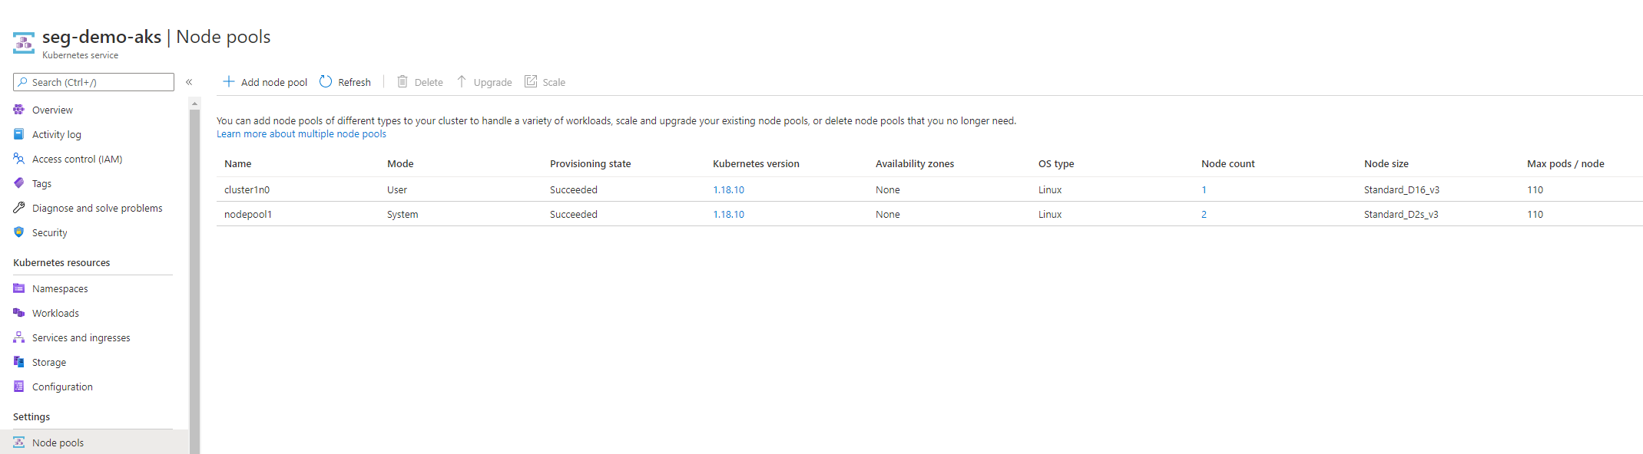
Azure Kubernetes Service
AKS is managed on a VM used only for monitoring and uses system node pool & user node pool.
The performance of AKS depends on the specification of VM for user node pool.

Slide 8
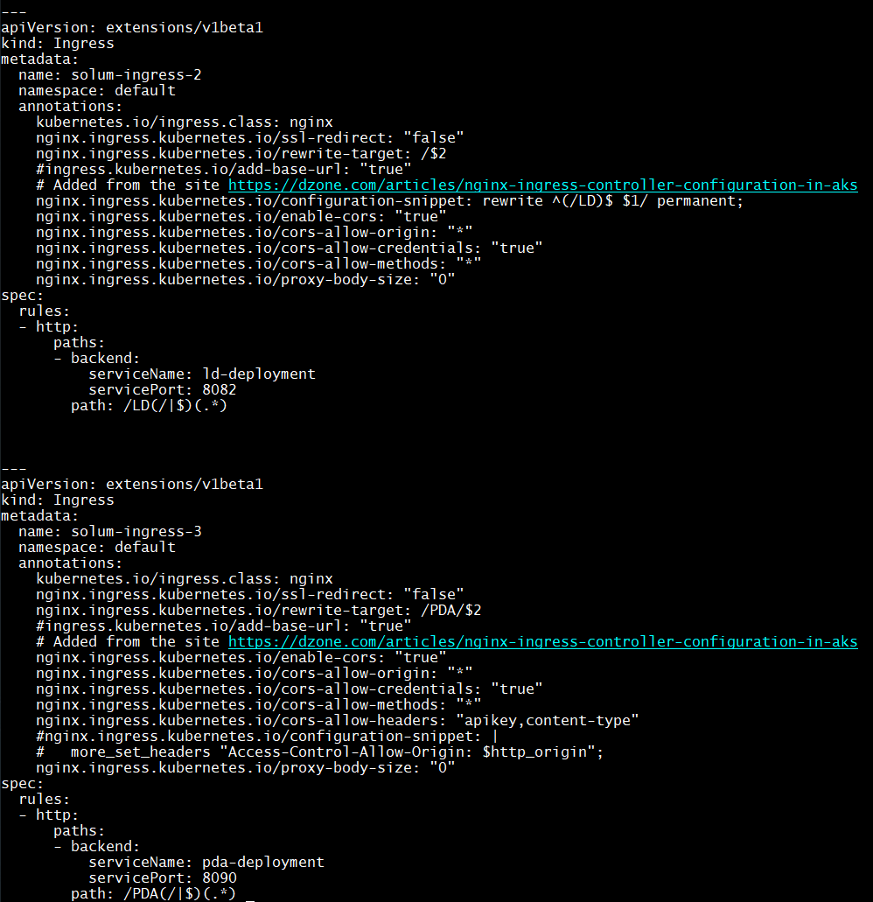
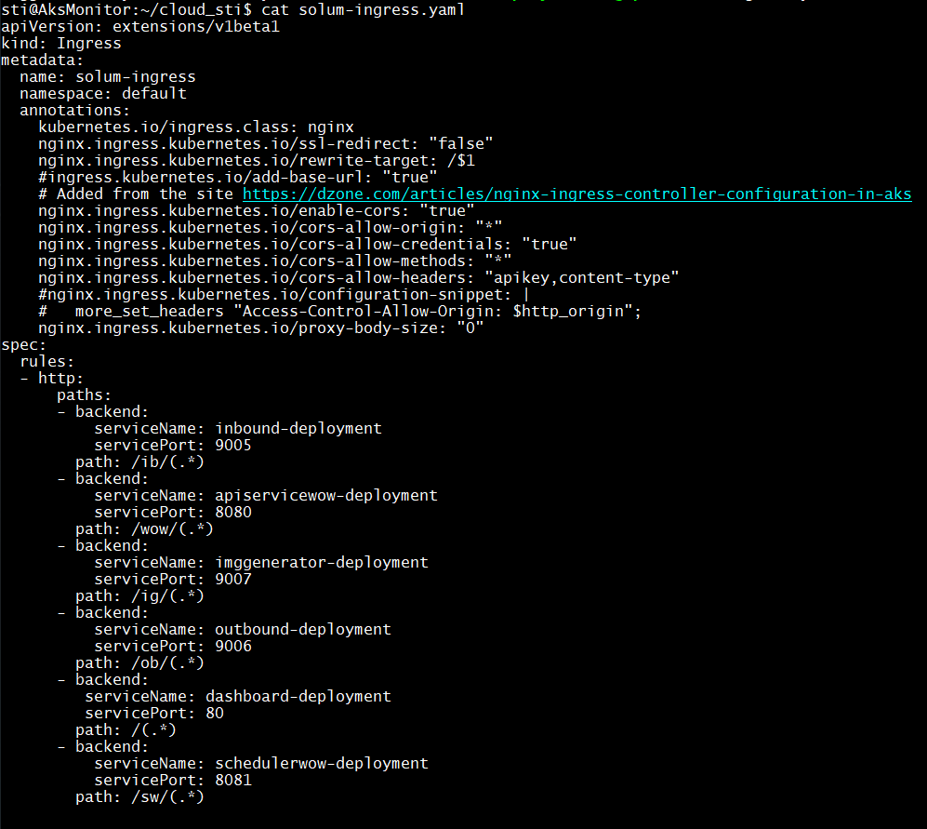
Ingress rules
The below represents some rules used on AKS.

Slide 9
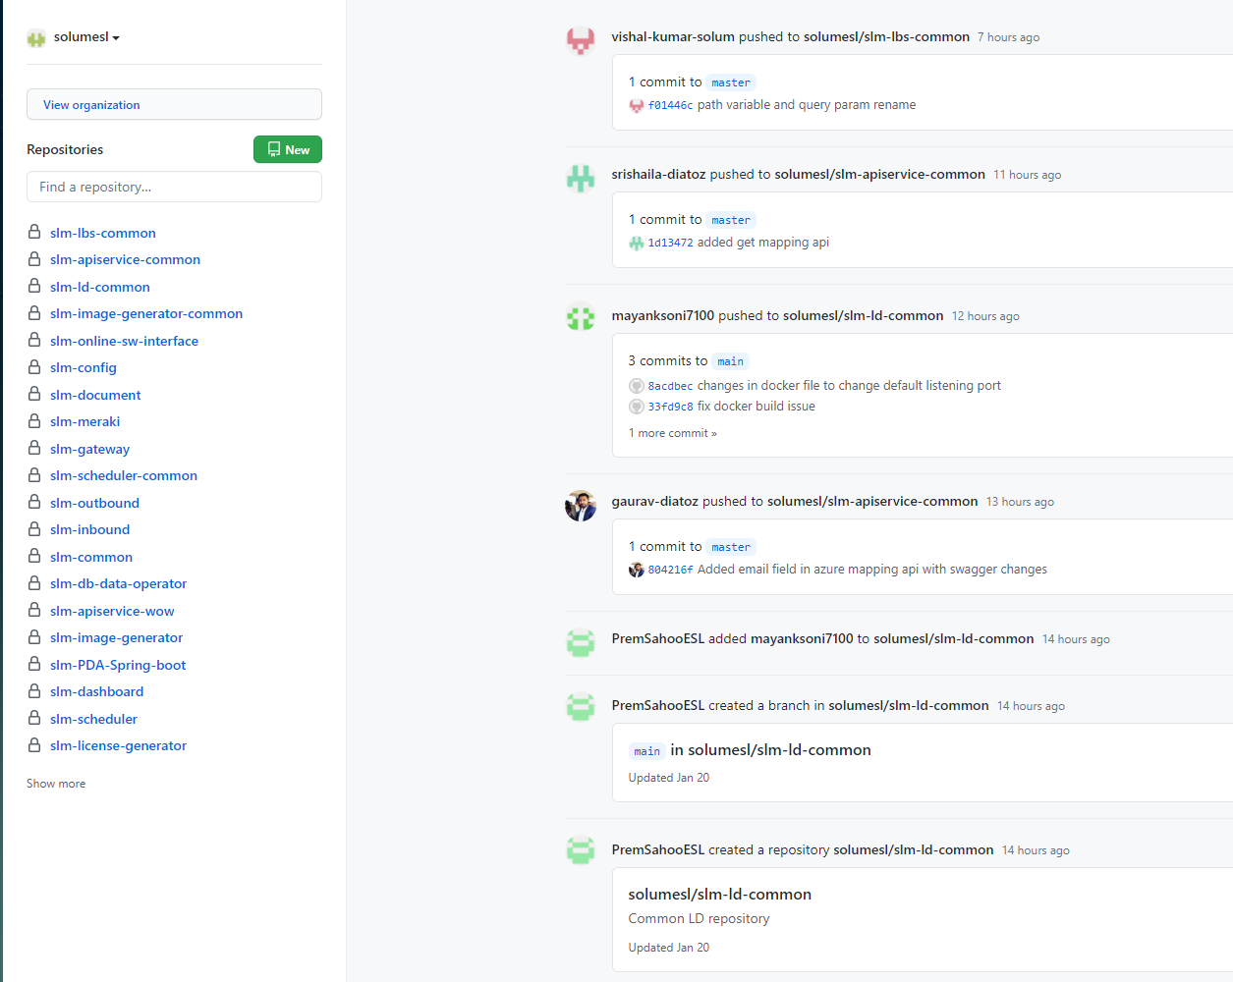
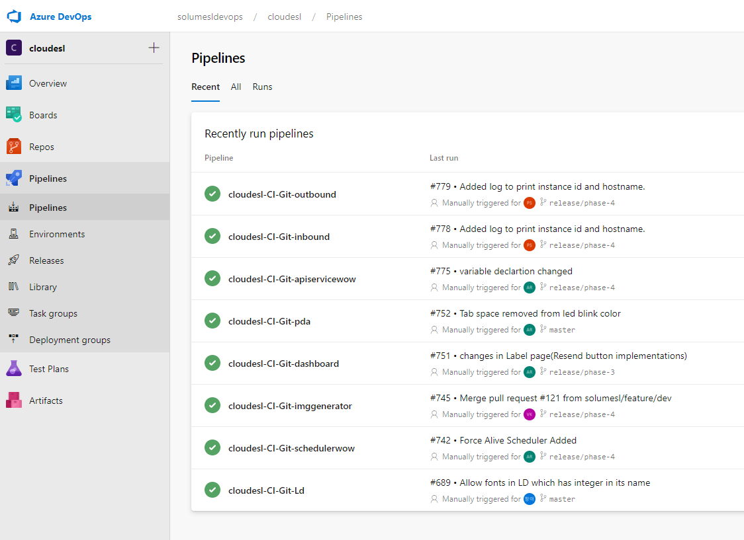
Github & Azure DevOps
All source codes are managed on Github and built on DevOps.
The docker files which are made after building the source codes on DevOps are stored on Azure Container Registry.

Slide 10
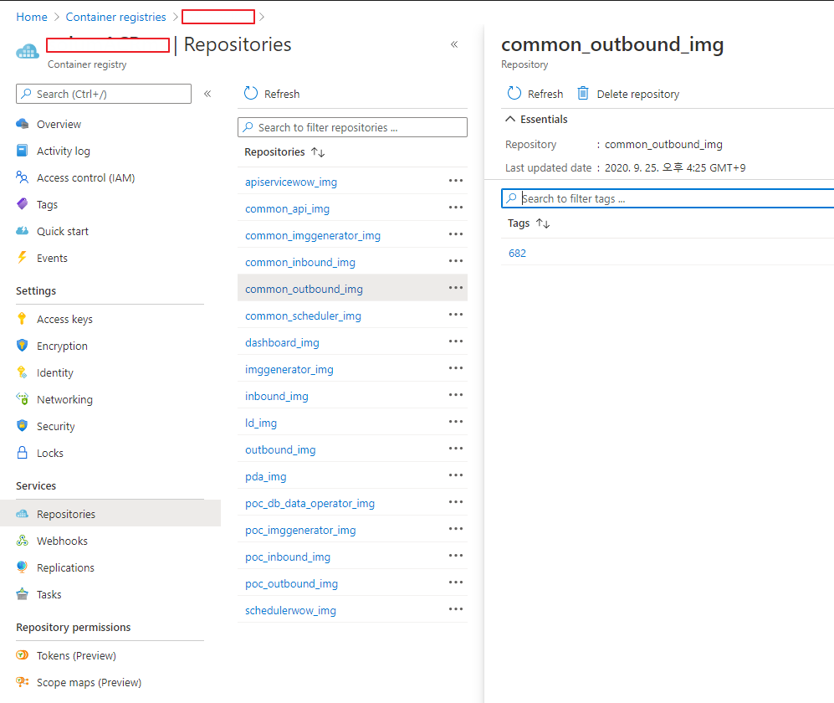
Azure Container Registry
AKS pulls the Docker images from Azure Container Registry (ACR)

Slide 11
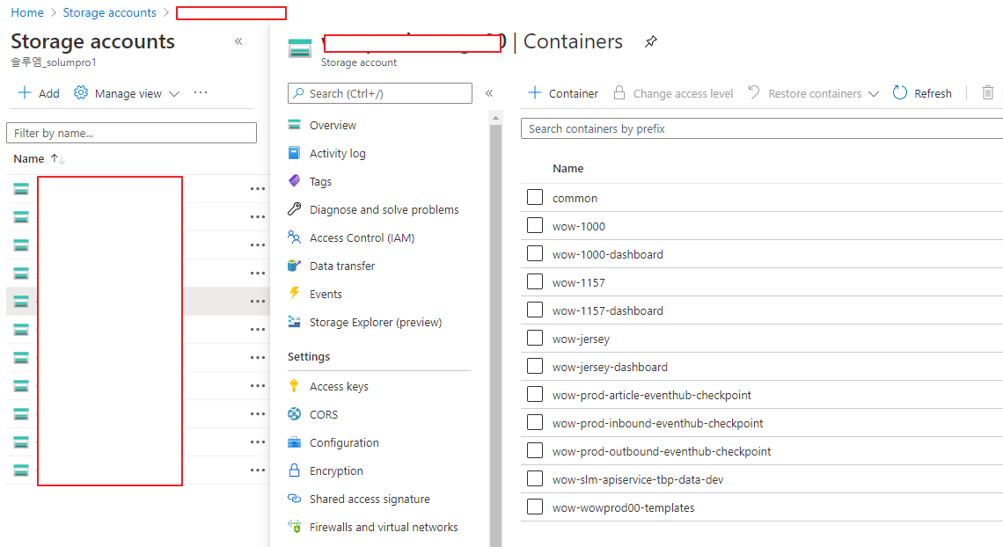
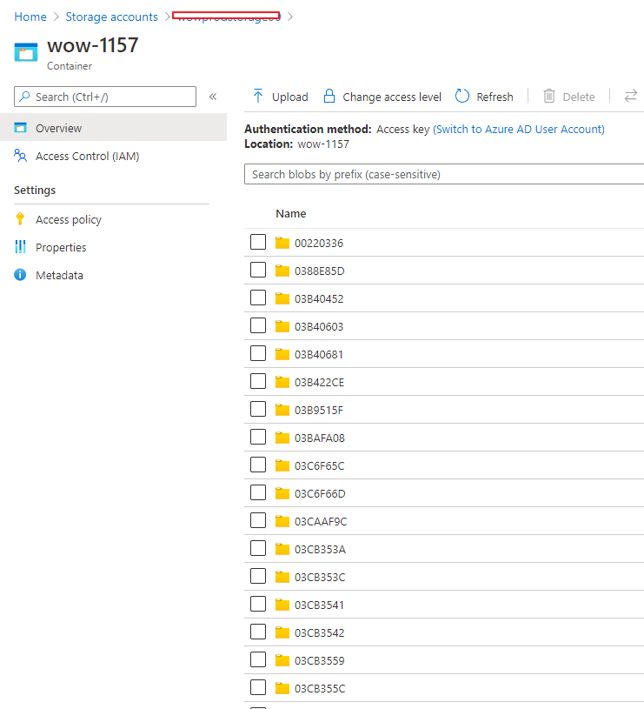
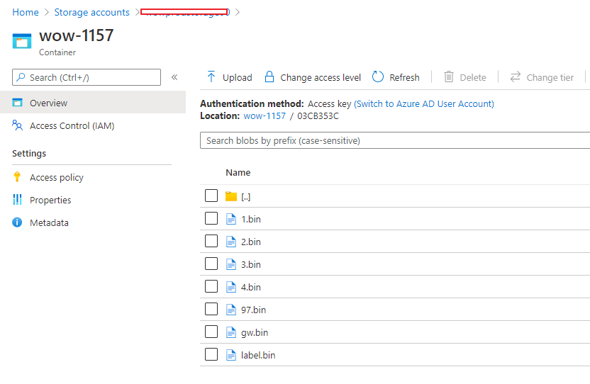
Azure Storage
When a label is connected to a GW, the GW updates the activation information (for roaming) of the label on Storage.
Some files (Images, NFC and others) are stored on Azure Storage and GW will pull the files after receiving messages from Server through IoTHub.

Slide 12
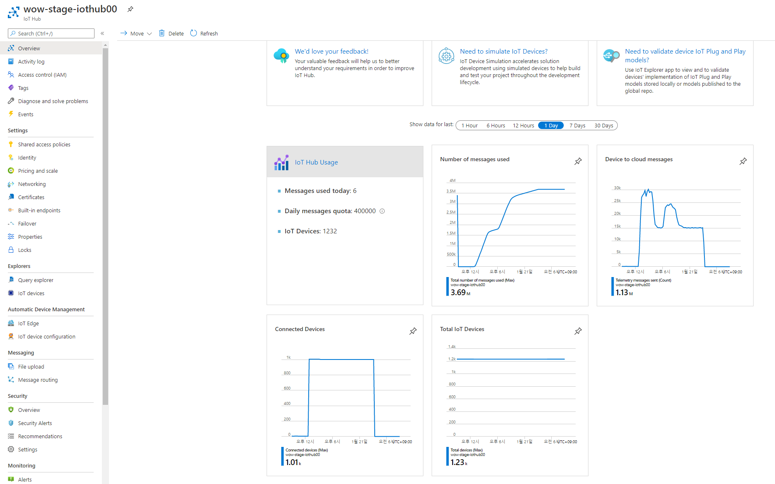
IoTHub
IoT Hub is a managed service, hosted in the cloud, that acts as a central message hub for bi-directional communication between your IoT application and the devices it manages.
The below picture shows the results tested by using 1K GW simulators (based on Docker) on running on Azure VM.

Slide 13
Test Results (Released to SAI)
[Common]
[Warning] The performance greatly depends on the specification of used VMs, which is also related with the costs.
In the test,
All services described in the structure are used.
Azure Application Gateway, Azure Kubernetes, Ingress Controller, Azure Storage, PostgreSQL, MongoDB, IoTHub, EventHub
we have used ESL GW simulators running on x64 VM and each ESL GW processes 5K labels.
Autoscaling mode is enabled for both Image Generator and API service modules running on Azure Kubernetes.
Image Generator microservice : used for generating images of ESL labels
API Service microservice : used for handling API calls from users or dashboard
The below results depend greatly on the size of the Virtual Machines and the number of Virtual Machines used for autoscaling.
If we use VMs with higher specs and more VMs, we can get better results but it costs higher.
Total Labels | # of Stores | # of GWs | # of VM instances for GW simulator | # of Image Generator | # of APIService
1M | 1 | 200 | 2 | 2 ~ 10 | 2
1M Labels can be processed within 150 mins in an ideal situation (Clear RF environment).
User Node Spec - Standard_D32_v3 (32 CPU Cores), Min.1 ~ Max. 4 (Enabling autoscaling)
Total Labels | # of Stores | # of GWs | # of VM instances for GW simulator | # of Image Generator | # of APIService
25K | 1 | 10 | 1 | 1 ~ 5 | 1 ~ 2
25K can be completely processed within 30 mins in an ideal situation (Clear RF environment)
User Node Spec - Standard_D16_v3 (16 CPU Cores) Min.1 ~ Max. 3 (Enabling autoscaling)

Slide 14

THANK YOU

